Slide 1
Software as a Service
- Concepts and Implementation-
Ólafur Gauti Guðmundsson
ogg@rendezviewonline.com

Slide 2

Overview
Brief intro to the SaaS concept
Example: rendezviewonline.com
Simple SaaS implementation

Slide 3
What is SaaS?
Model for software deployment
The software is hosted as a service
All data is therefore stored centrally
The service is accessed via web-based interface
Users subscribe to the service for a capacity-based fee

Slide 4
Benefits of SaaS
For the user:
  No setup, no maintenance to worry about
  No need to go through the IT deparment
  Less risky investment, no huge license fees to pay up front
For the vendor:
  All clients running on same release, less support hassle
  Attractive revenue model
  Better control over intellectual property

Slide 5
Things to consider…
Is the content secure and safe?
Can data be exported?
SaaS is often less customizable
Dependent on access to internet
SaaS is not a solution for everyone.

Slide 6
A few SaaS examples
Salesforce.com (CRM)
Google apps (Gmail, Google Docs, GCal, etc.)
37signals.com (Basecamp, Campfire, etc.)
Freshbooks.com (Invoicing, etc.)
Edicy.com (websites)

Slide 7
Rendezview
Founded and built by two guys from Iceland
One lives in Reykjavik, the other in London
No investors, no office, no sales people :)
SaaS model
Currently in closed beta testing
Aiming to launch January 2009

Slide 8
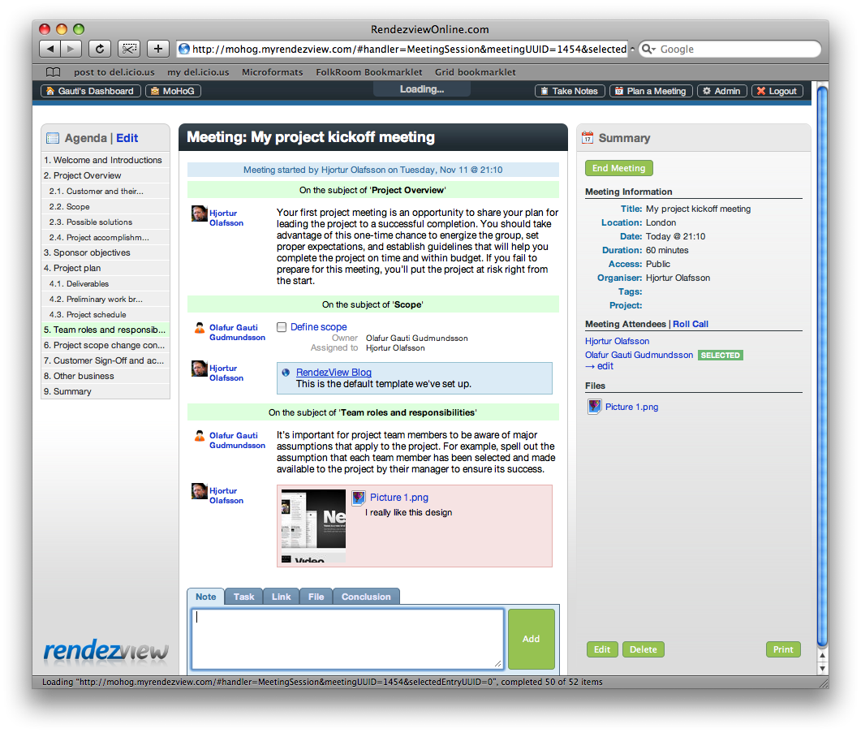
Rendezview - DEMO

Slide 9
Starting SaaS
When starting a SaaS you need to think about:
  The infrastructure (email, etc.)
  Where and how are you going to host the software?
  Source code control, issue tracking, release management
  How do you provide support to your users?
  How do users pay their subscription fees?
  How do we make sure it works in all browsers?

Slide 10

Infrastructure
Google Apps (http://www.google.com/apps)
  Email (using your own domain name)
  Docs
  Calendar
Cost: Free

Slide 11

Hosting
Amazon Elastic Compute Cloud (EC2)
  Virtual servers
  Can start up a new server in 2 minutes
  Elastic IP
  Elastic Block Storage
  Location control
Cost:
  $0.10 per instance hour
  $0.10 per GB in
  $0.17 per GB out for the first 10 TB, then goes down

Slide 12

Source code control
.com
  Subversion og GIT repository hosting
  Issue tracking, release management and project management
Cost:
  Unlimited number of repositories
  1 active project
  2 users
  Free!

Slide 13
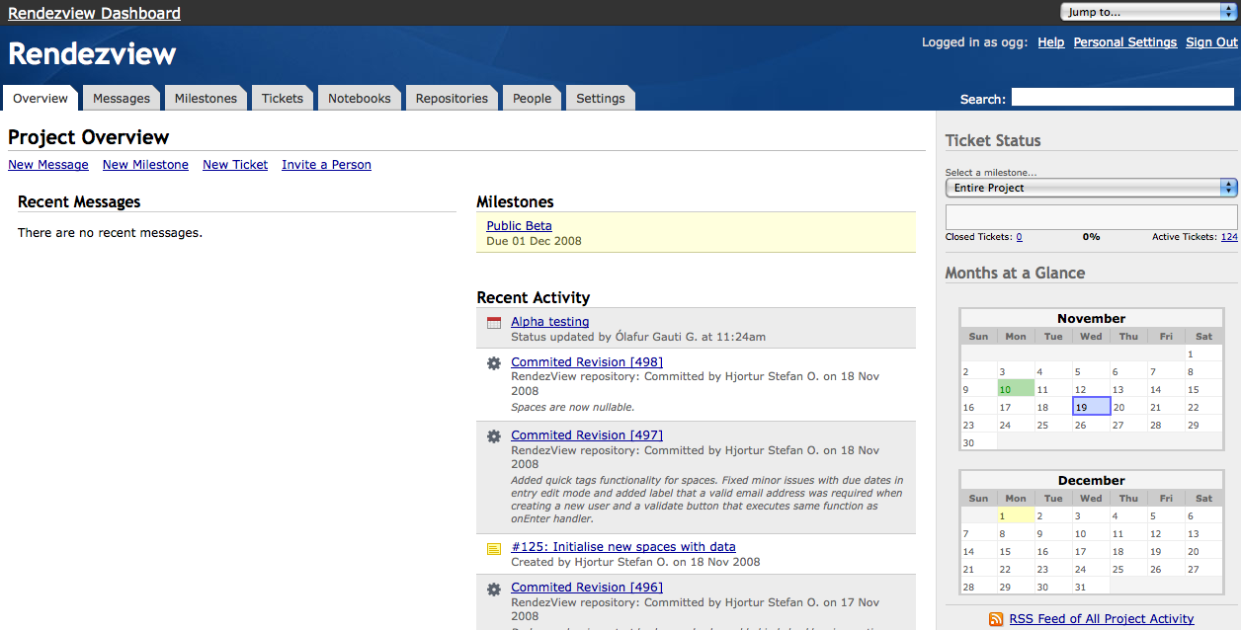
Source code control
Unfuddle.com

Slide 14
Support
Getsatisfaction.com
  Questions and discussions, suggestions, bug reports, etc.
  Company employees AND other users can answer
  “The wisdom of crowds”
  Host your own branded Helpcenter
Cost: Free

Slide 15
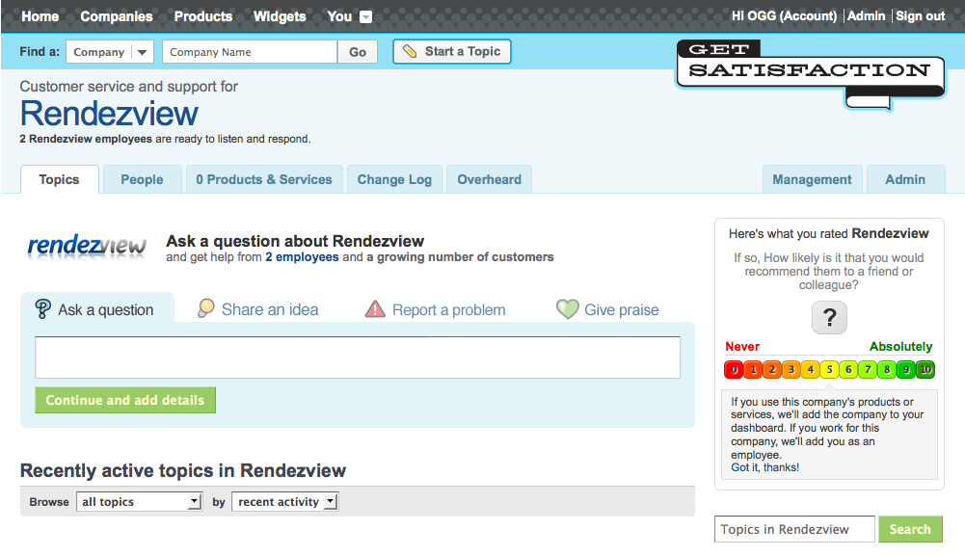
Support
getsatisfaction.com

Slide 16

Payment
PayPal
  Supports recurring payments
  Payment can take place on the PayPal site
  Customize and brand the landing page
  User doesn’t need a PayPal account to pay
Cost:
  3.4% + €0.35 per transaction in Europe
Notes:
Adyen er annað stórt nafn.

Slide 17
Works in all browsers?
Google Web Toolkit (GWT)
  Framework to build AJAX web solutions
  Write client and server in Java, use GWT to compile to JavaScript
  Generates separate optimized version for each browser
  “Hosted mode”: change client and view without recompiling
  You can debug your AJAX code
  Supports history (the back button) and “deep linking”
  Supports i18n out-of-the-box
Cost: Free
Notes:
svipað og swing
mikill fjöldi af widgetum, auðvelt að smíða sín eigin
annað mjög svalt: hliðrar sjálfkrafa tímabeltum

Slide 18
Open source software
We use a lot of open source software
Maven 2 – dependency management and builds
Lucene / Solr – powerful search
Hudson – continuous integration

Slide 19
Conclusion
You don’t need to spend lots of money to implement SaaS
All you need is:
  A great idea
  Right attitude
  Lots of time
  Big Cojones :)

Slide 20
The right attitude
“Scratch your own itch”
Don’t try to create the next Facebook
Make good software at a great price
Set a reachable goal:
  400 users * $40 * 12 months = $200.000
  If 5% of those who register pay for subscription:
    400 = 5% of 8000 registrations
    Ca 22 users must register each day of the year

Slide 21
Thanks for listening!
Ólafur Gauti Guðmundsson
ogg@rendezviewonline.com

